Slide 1
Ethical Hacking
Kamlesh Kumar
Amit Yadav
Somesh Choudhary
SUMMER'17
Mid Term Evaluation

Slide 2
Ethical Hacking
Ethical hacking: This is a project about finding and exploiting various security bugs in a program. This is mostly based on system and browser based vulnerabilities.
Contents:
Basic linux command
ssh login
Assembly Language
Buffer overflow
pwntools

Slide 3
Linux Basics
Read, Write & Execute Permissions
Permissions are the basic "rights" to act on a file or directory. The basic rights are read, write and execute.
Read - a readable permission allows the contents of the file to be viewed
Write - a write permission on a file allows you to modify the contents of that file.
Execute - for a file, the executable permission allows to run the file and execute a program.
We can view permissions for file for directory by ls –l command.

Slide 4
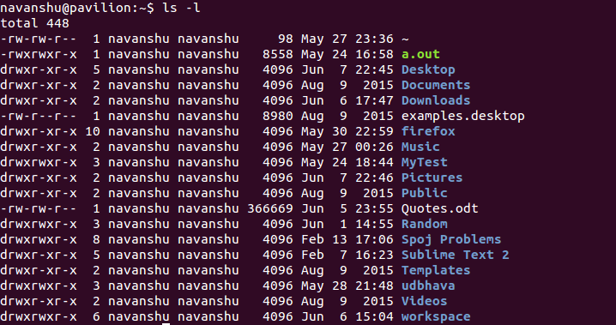

Slide 5
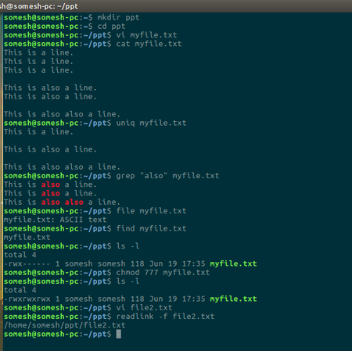
chmod
grep
cat
file
ls
cd
find

Slide 6
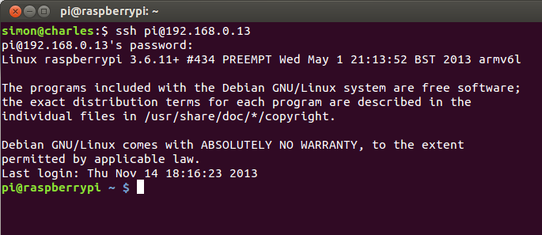
SSH (the Secure Shell)
Using SSH requires a client on the local computer and a server on the remote one.
It establishes an encrypted connection to a remote computer, executes a command there and redirects its input and output across the connection.

Slide 7
Assembly Language
Assembly language is a low-level programming language.
Assembly language is converted into executable machine code by an assembler.
Computer basically consist of two things: CPU and memory.
And there is some internal memory (registers) only accessible to CPU.

Slide 8
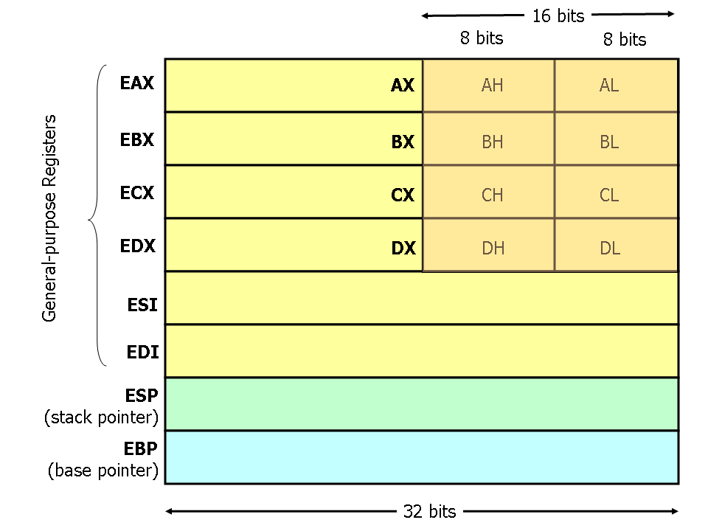

Slide 9
Some Assembly Instructions
mov eax, ebx — copy the value in ebx into eax
push eax — push eax on the stack
lea eax, [var] — the value in var is placed in EAX.
jmp begin — Jump to the instruction labeled begin

Slide 10
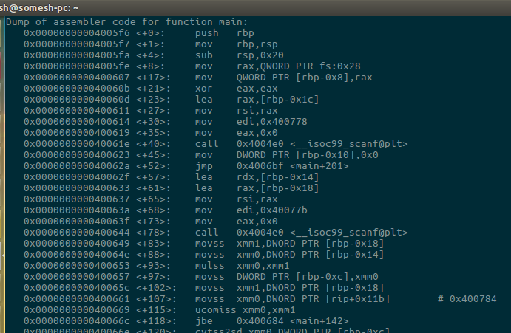

Slide 11
Program Memory
Stack
Unused memory
heap
.bss
.data
.text
Used for storing function argument and local variable
Dynamic memory-malloc()
Uninitialized data
Initialized data
Program code

Slide 12
General Stack Layout
int AddMe(int a, int b)
{
int c;
c=a+b;
return c;
}
main(){
AddMe(10,20)
print();
return 0;
}
0xffffffff
Arg2
Arg1
RET
EBP-old
Local var
High memory
12(%EBP)
8(%EBP)
4(%EBP)
%EPB
-4(%EBP)

Slide 13
Buffer overflow
Simple Vulnerable Function:
Buffer: A Temporary space in memory used for hold data.
Buffer overflow: Happens when data written to the buffer is larger then size of buffer and due to insufficient bound checking it overflows and overwrites adjacent memory location.
GetInput{
Char buffer[8];
gets(buffer);
puts(buffer);
}
Gets() does not check if input size is greater than size of buffer

Slide 14

Pwntools
CTF framework
Written in python
Makes exploitation easy
>>> from pwn import * # it imports a lot of functionality into global namespace
>>> p=process('/bin/sh') # starts process
>>>p.sendline('input') # sends input
>>>p.recvline(timeout=5) # receives output

Slide 15
Live Demo on buffer overflow
Code::
#include<stdio.h>
#include<stdlib.h>
#include<unistd.h>
#include<string.h> int main(int argc, char* argv[]){
if(argc == 2){
if(filter(argv[1]))
exit(1);
else{
setenv("PATH", "/nonsense", 1);
printf("%s", argv[1]);
system(argv[1]);
}
}
else{
printf("Usage: ./cmd COMMAND\n");
exit(1);
}
return 0;
int filter(char *s){
int r = 0;
r+=(int)strstr(s, "/");
r+=(int)strstr(s, "sh");
r+=(int)strstr(s, "*");
r+=(int)strstr(s, "flag");
r+=(int)strstr(s, "who");
r+=(int)strstr(s, "PATH");
r+=(int)strstr(s, "=");
r+=(int)strstr(s, "{");
r+=(int)strstr(s, "}");
return r;
}

